Slide 1
Mantid Current Development and other news
Nicholas Draper
Scientific Steering Committee 2015

Slide 2
Agenda

Slide 3
mostly framework

Slide 4
6 Month view
Items currently under development
Tiling displays
Multi data fitting
CLI (for VATES)
Planned development starting <6m
Workflow Algorithms
History depth / extracting scripts
Masking redesign(LT)
Improve GUIs
Improve Vates defaults
Documentation maintenance (ongoing)
Load performance
Plotting improvements
Repo. for instrument files
Spec API for instr. control

Slide 5
Planned development starting ~12m
Planning tools
Resolution convolution
Multiple scattering sub project
Parallel algs
Parallel fitting (quantification)
Interface to 3rd party packages
Vates pub. quality plots
CLI improvements
Instrument control implementation

Slide 6
Planned development starting 12-24m
Remote Mantid project
Vates client/server
units

Slide 7
Planned training courses starting 12-24m
VATES
Py-QT
Technique specific i.e. SANS interface
Investigate links to external neutron training schools
In use at ISIS neutron training course

Slide 8
Science specific areas

Slide 9
SANS
Corrections
delQ 6m
Absorption 12m
Model fitting 12m
Others (12-24)

Slide 10
Reflectometry
Unify UIs
SNS complex 12m
ISIS simple 6m
Integrate SNS magnetism into Mantid 12m
Offspec tools sub project 24m

Slide 11
Diffraction
Fix rectangular detector issues 6m
Visible Time-slicing
Easy GUI 12m
Fast logs 12m
Single xtal UX 6m
crystal plan 12m
Unify Instrument calibration 24m

Slide 12
INS
Mslice interface 6m
Planning tools 12m
Compare model to data 12m
Vates improvements to UX 6m
Include different resolution models 6m
TAS 24m

Slide 13
Unexpected
Imaging and IMAT
ISIS Live Data rate
Paraview version changes
MD workspace create rate issues
The rise of Autoreduction

Slide 14


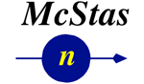
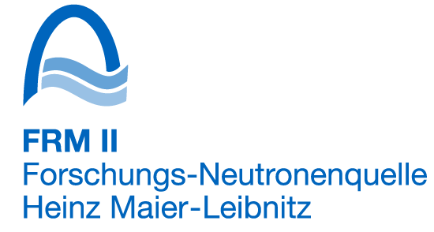

Contributors
NMI3 supported evaluation
IN4,5 & 6
D33
Focus
Lujan Nexus Load algorithm
Improving McStas – Mantid integration
LoadMcStas
TofTof

Slide 15
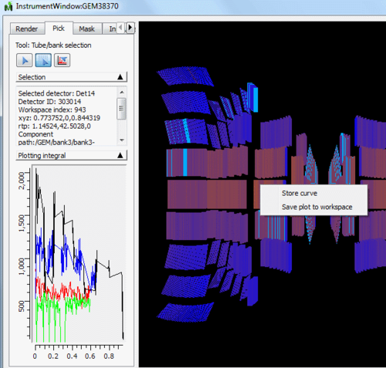
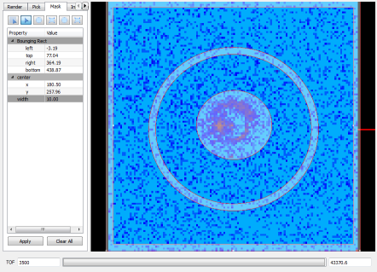
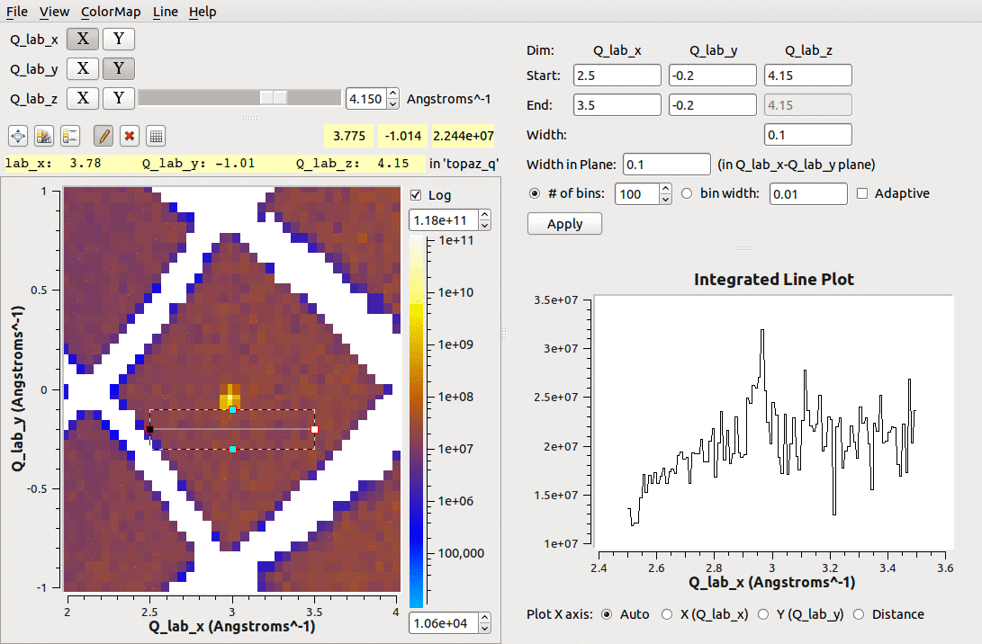
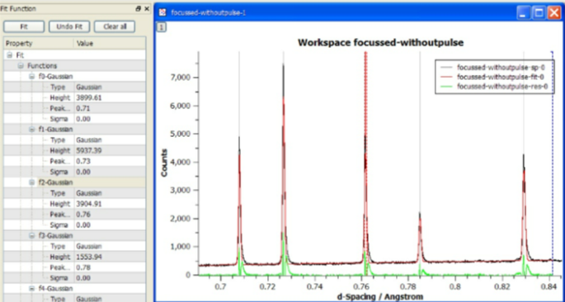
What we can do - Tools

Slide 16
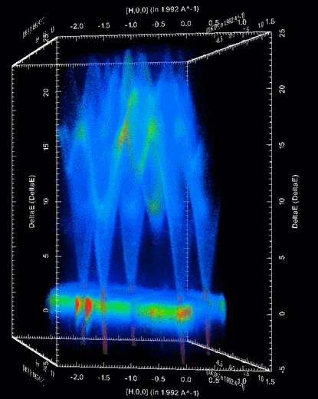
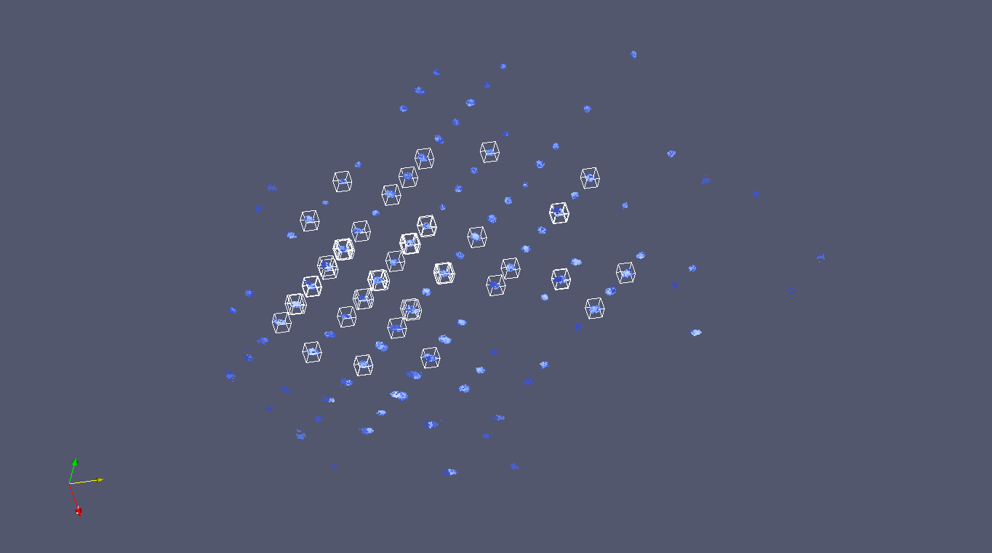
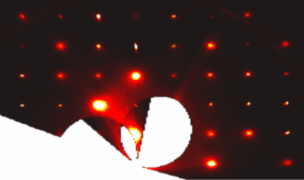
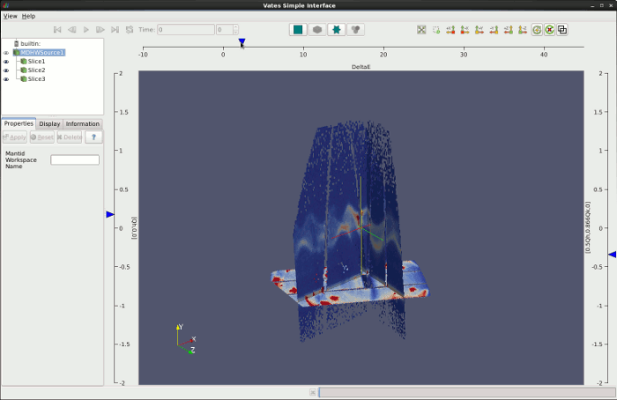
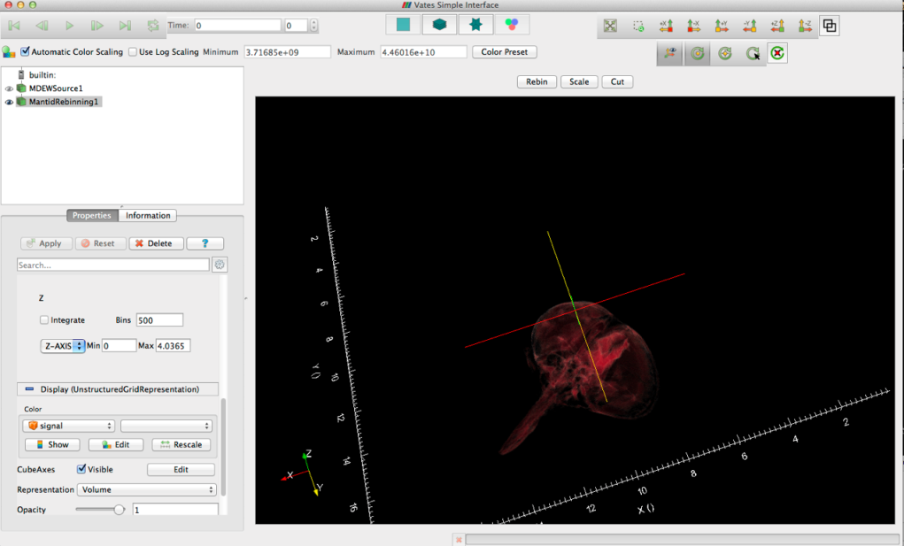
What can we do - Visualization

Slide 17
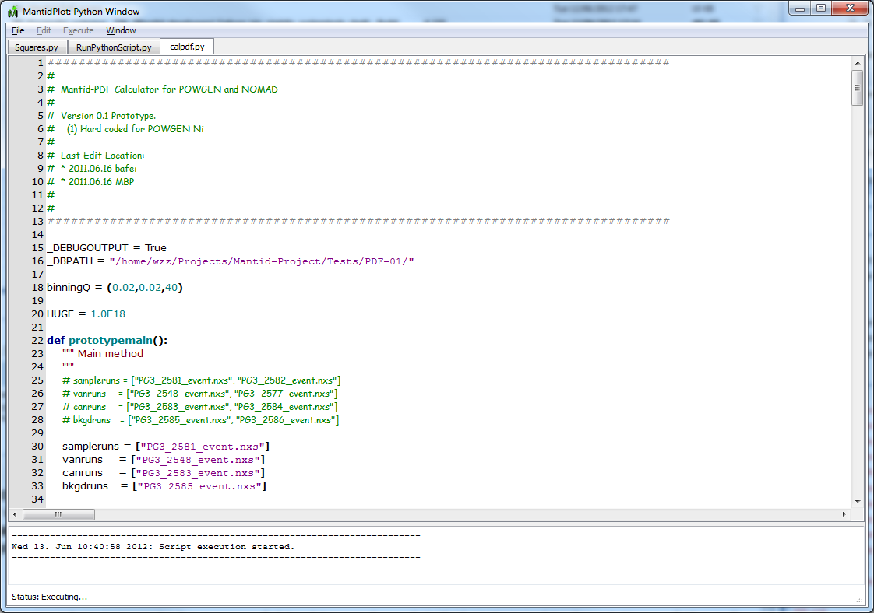
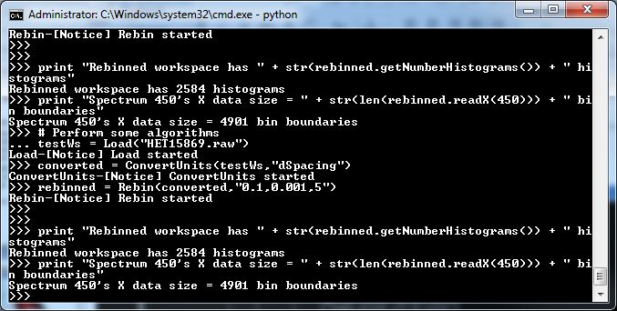
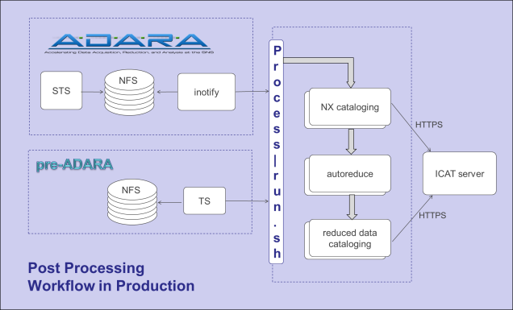
What we can do - Scripting
Python Control
Within MantidPlot or command line
iPython Shell
Integrated numPy
Python Plugins
Algorithms
Fitting functions
User interfaces
Automated reduction

Slide 18
Cleaner Interface
Simplified Tool bar redesign
Instrument View improvements
Default unwrapped views for instruments, side by side view
Improved tools for selection, masking and grouping
Display of guides, choppers etc
Easily see Monitors and details of grouped detectors
Offline Help
New ICAT interface

Slide 19
Framework
File loading improvements
Capability and performance
Curve fitting and optimisation
Stability of back to back exponential curve fitting
Visualization of Structure Factors from Molecular Dynamics Simulations (Sassena integration)
Tube Calibration
Live Data
Parallel reduction

Slide 20
Visualisation
Incorporation of features developed with Kitware
Visualization of non orthogonal data
Ability to provide axis labels from datasets
Ability to provide "time" label from datasets
Allow override of axis extents for displaying original extents
Porting of the MultiSlice view into ParaView proper
QuadView (ThreeSlice) plugin that incorporates coordinate readout and dynamic slice repositioning

Slide 21
Python
Managed removal of Python V1
Adoption of Ipython in all environments as the Mantid script interpreter
Implementation of a Script Library to support user sharing

Slide 22
Inelastic
Direct Inelastic
DGSReduction
Indirect
Many improvements throughout convert to energy and Indirect Data Analysis
Indirect BAYES inteface
Now completely replaces all MODES functionality
FORTRAN modules supported in 32 & 64 bit windows

Slide 23
Large Scale Structures
SANS
Beam centre correction for the High Angle Bank of LOQ and SANS2D
Support for Wide angle corrections
Support for CANSAS v1.1
Reflectometry
Stitch1D created to make stitching 1D data easy
Support for various reflectometry plots

Slide 24
Diffraction
Powder Diffraction
Many improvements to AlignAndFocusPowder
LeBailFit and associated algorithms which can be used to determine an initial FULLPROF parameter file.
Single Crystal
Single Crystal Diffraction User Interface
Integration techniques have been modified and new ones developed:
IntegrateEllipsoids
IntegratePeakTimeSlices
CreateFractionalPeaks to support magnetic scattering
PeaksViewer
Peaks overlays in VSI

Slide 25
Outstanding Requirements
Improving support for instruments
Engin-X, GEM, Larmor, Vesuvio, Muons, reflectometry
Autoreduction
expand use at ISIS
ICAT
uploading data
implementation for SNS
cross facility queries
Live data
include log data (ISIS)

Slide 26
Outstanding Requirements
Fitting
Develop GUI for multi dataset fitting with global and local parameters
Corrections
Implement complex sample environment multiple scattering corrections
VATES
Single Xtal
improve Peak integration & visualization of peak models
Implement Command Syntax
Quantification
Complete validation & expand models

Slide 27
Other groups interested in Mantid
Partners
ESS
C-SNS
ILL?
J-PARC?
Collaborators
PSI
ANSTO – Bilby
HMI - EXED

Slide 28
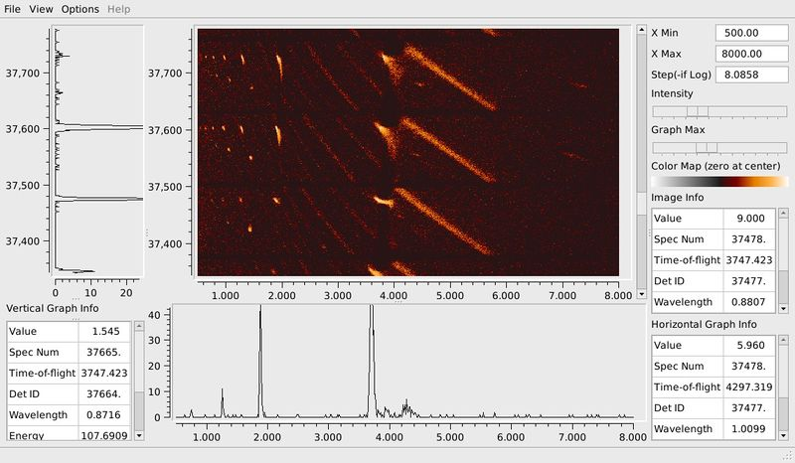
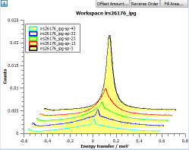
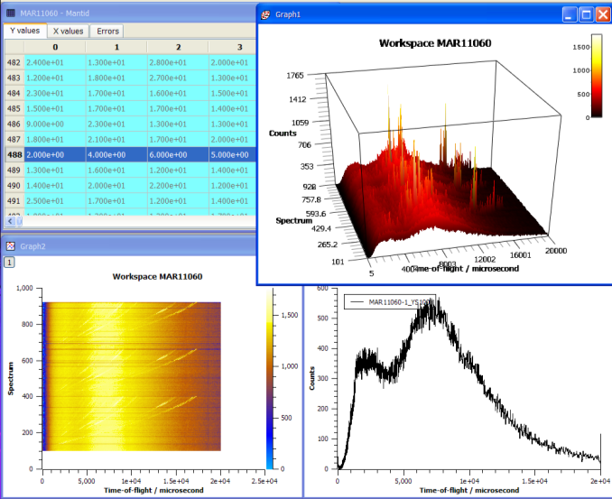
Our Graphs

Slide 29
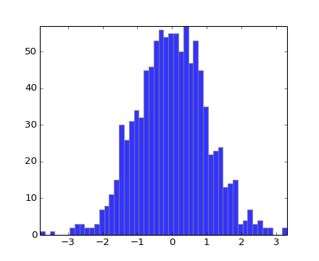
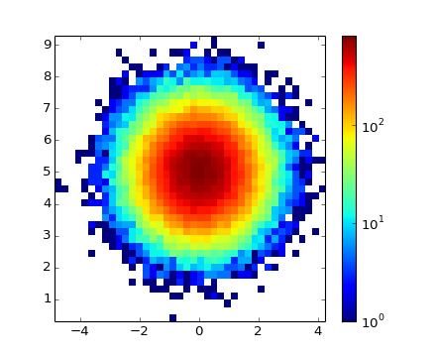
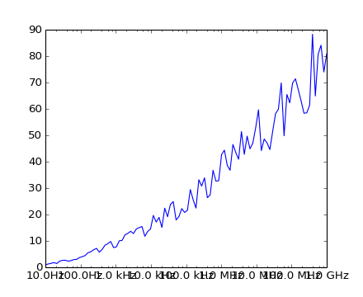
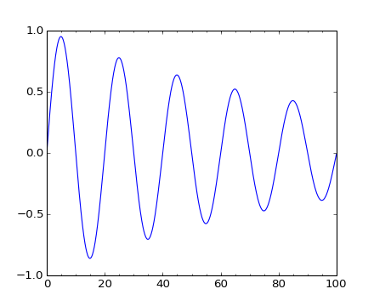
MatplotLib Graphs

Slide 30
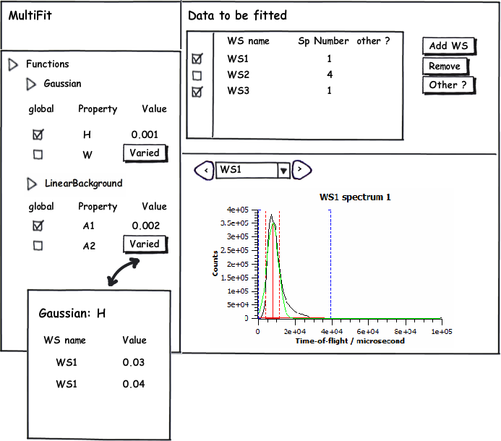
Multi data fitting gui

Slide 31

Future Plans

Slide 32
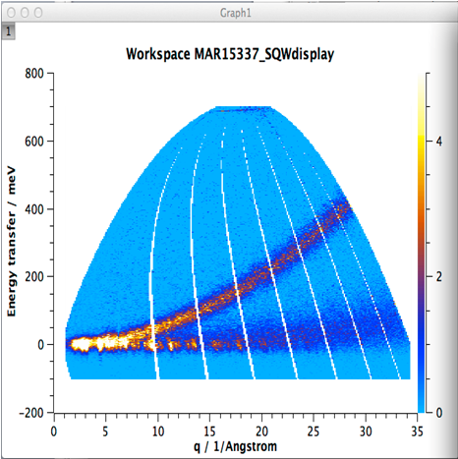
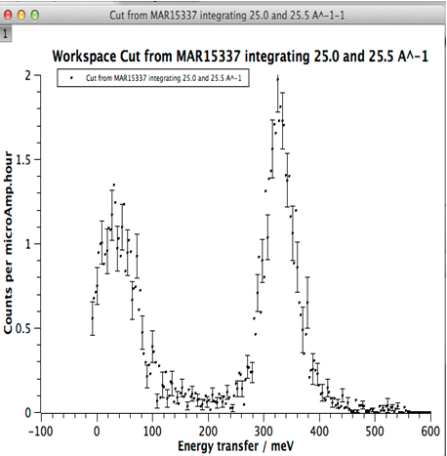
Intelligent Run Control
Define Region of interest
Define error bar criteria
BEGIN Run
Update from DAE & Reduce data to S(q,w)
Calculate statistic for ROI
Does statistic meet criteria
NO
YES
END run

Slide 33
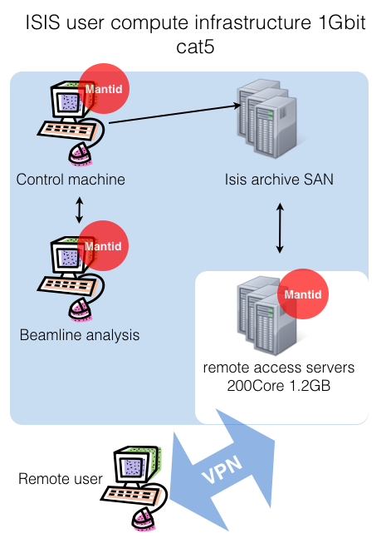
Current high Volume data
users need to:
Use SSH
Use VNC
Use VPN
federal ID and password
Also 3D views will not work well

Slide 34
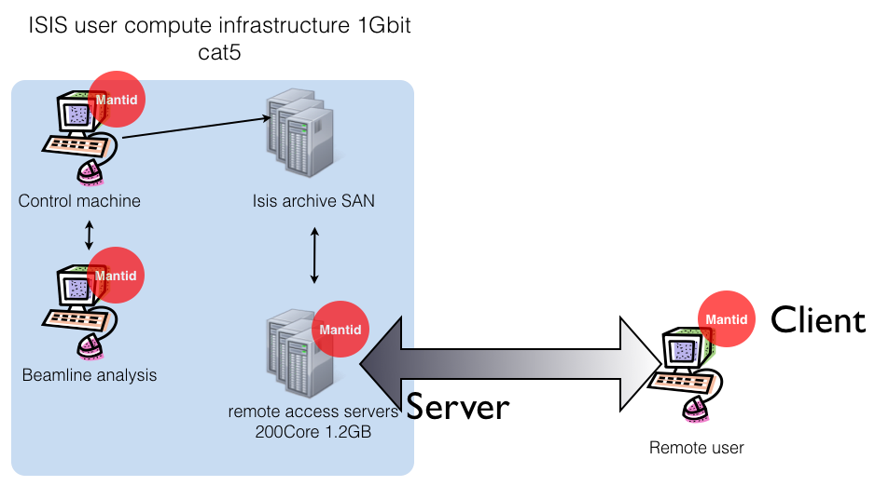
A possible solution

Slide 35
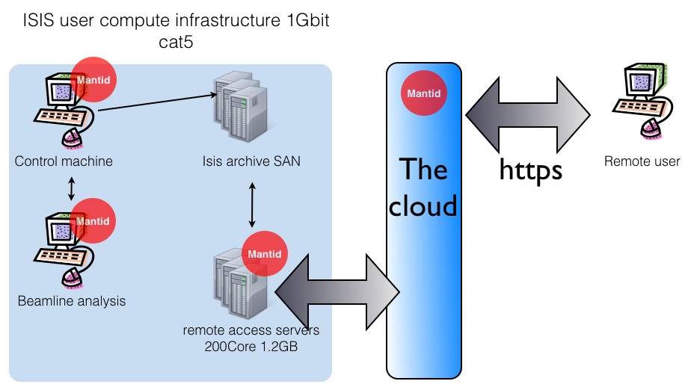
Web data access and reduction

Slide 36

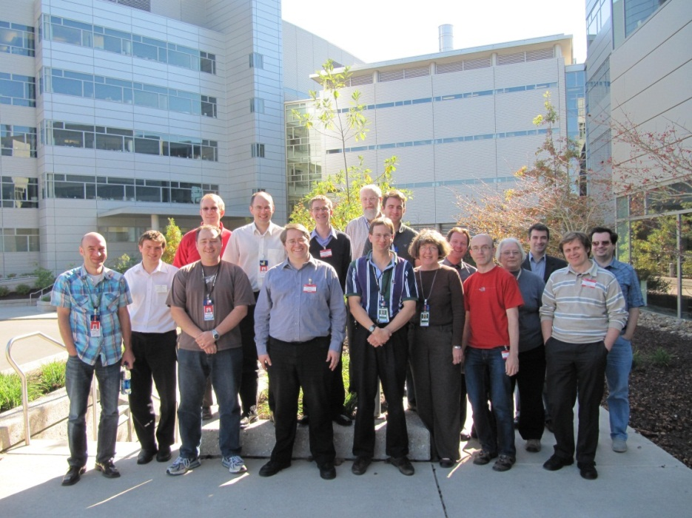

Further information
Project web page - www.mantidproject.org
VATES Poster - Poster Session B
Tessella - Stand 18
Many Thanks to the Project Sponsors
And the development team

